Slide 1
Arrays ADT
Guda Pranay Netha

Slide 2
Definition
An array is a data structure that stores a collection of elements, each identified by an index or a key. The elements in an array are typically of the same data type, and they are stored in contiguous memory locations. This allows for efficient access to elements using their index.

Slide 3
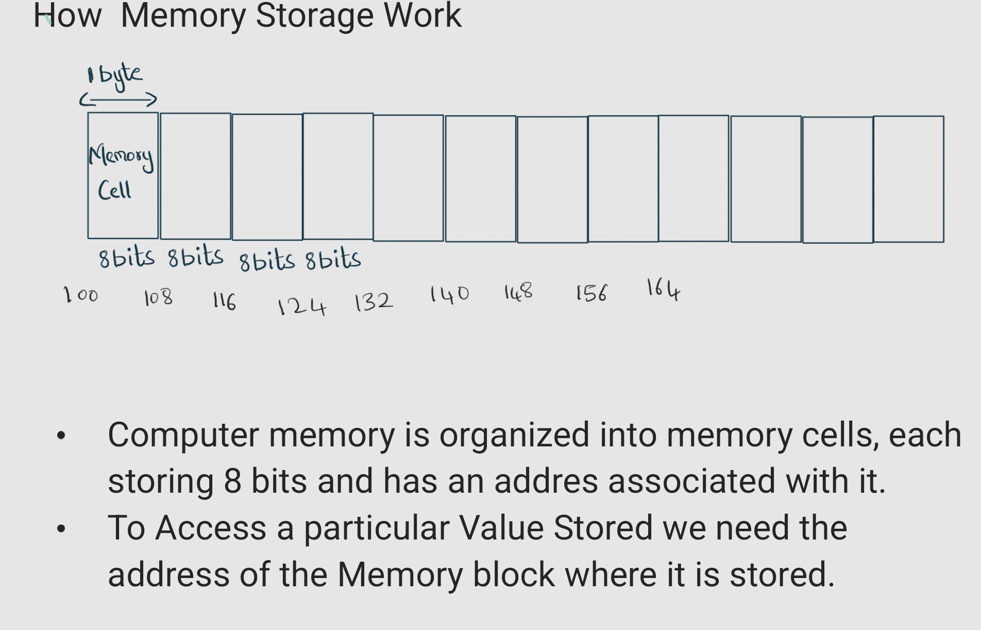

Slide 4
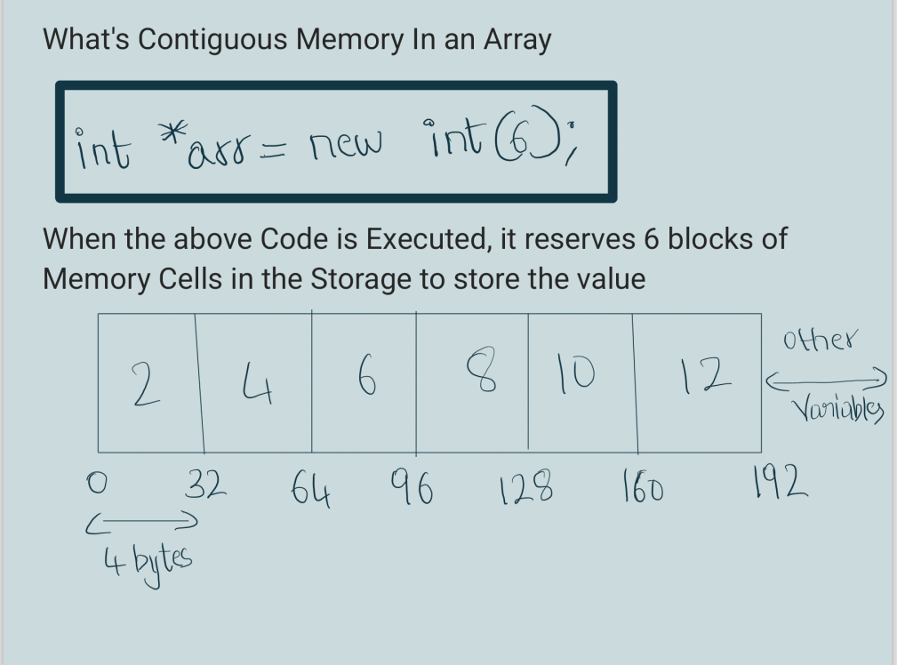






Slide 5
GIVEN AN "I" INDEX HOW DO ARRAYS CALACULATE ADDRESS IN MEMORY
Simple Formula:
Offset Address: Start Address of an Array(Represented as OF)
Size of Data Type Stored in Array: Let's Assume it to be S in Bits
Index : I
Address of Index I: (OF+S*I)

Slide 6
Elements of Array
Size Which Keeps Track of Current Index of the Array
Capacity- The Capacity if Array to Store the Elements
Array- A pointer to a Data structure Which is Stored in a Memory

Slide 7
Operations on a Array
Create-Array(n)
//Allocate an Array with size n
int[] array=new int[n]
Get-ith-Element(i)
// if index i< capacity Return Element at index i else throw an error
return array[i];

Slide 8
//Insert Element with Value:
Insert_Element(value):
If size<Capacity:
Array[size]=Value;
Size+=1
Else: Thow an Error Capacity Exceeded
//Remove Element:
Pop():
if size==0: Throw Error no Element to Remove
else:
size-=1

Slide 9
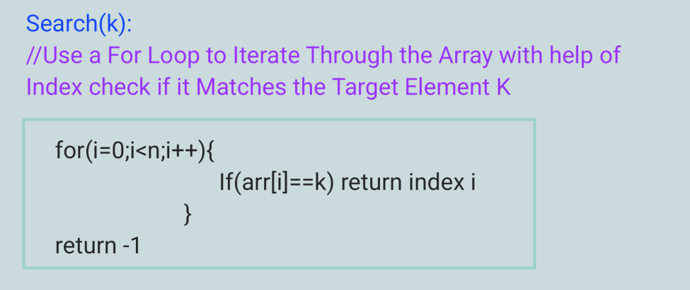

Slide 10
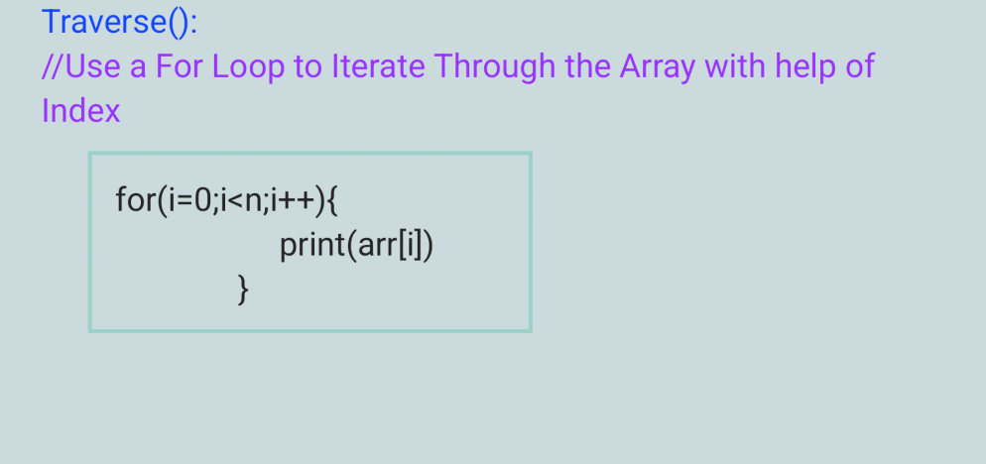

Slide 11
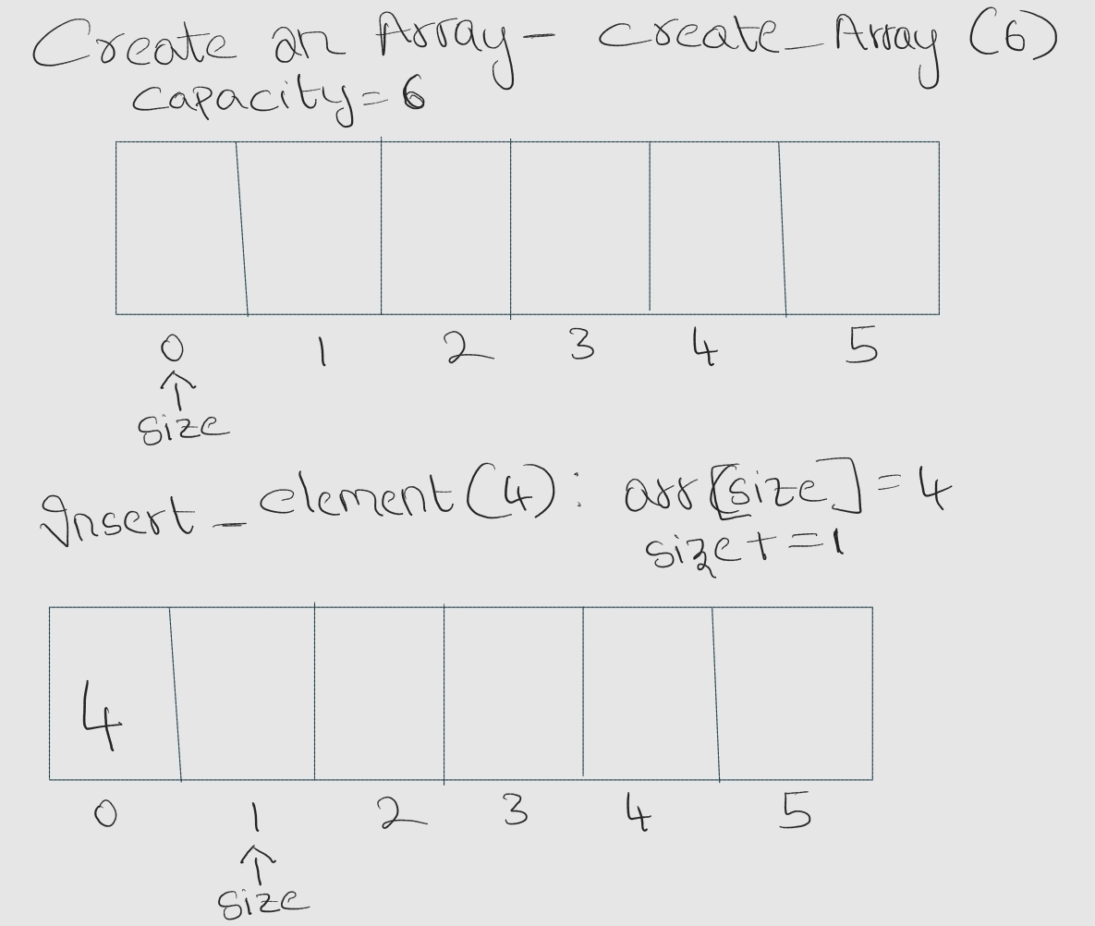

Slide 12
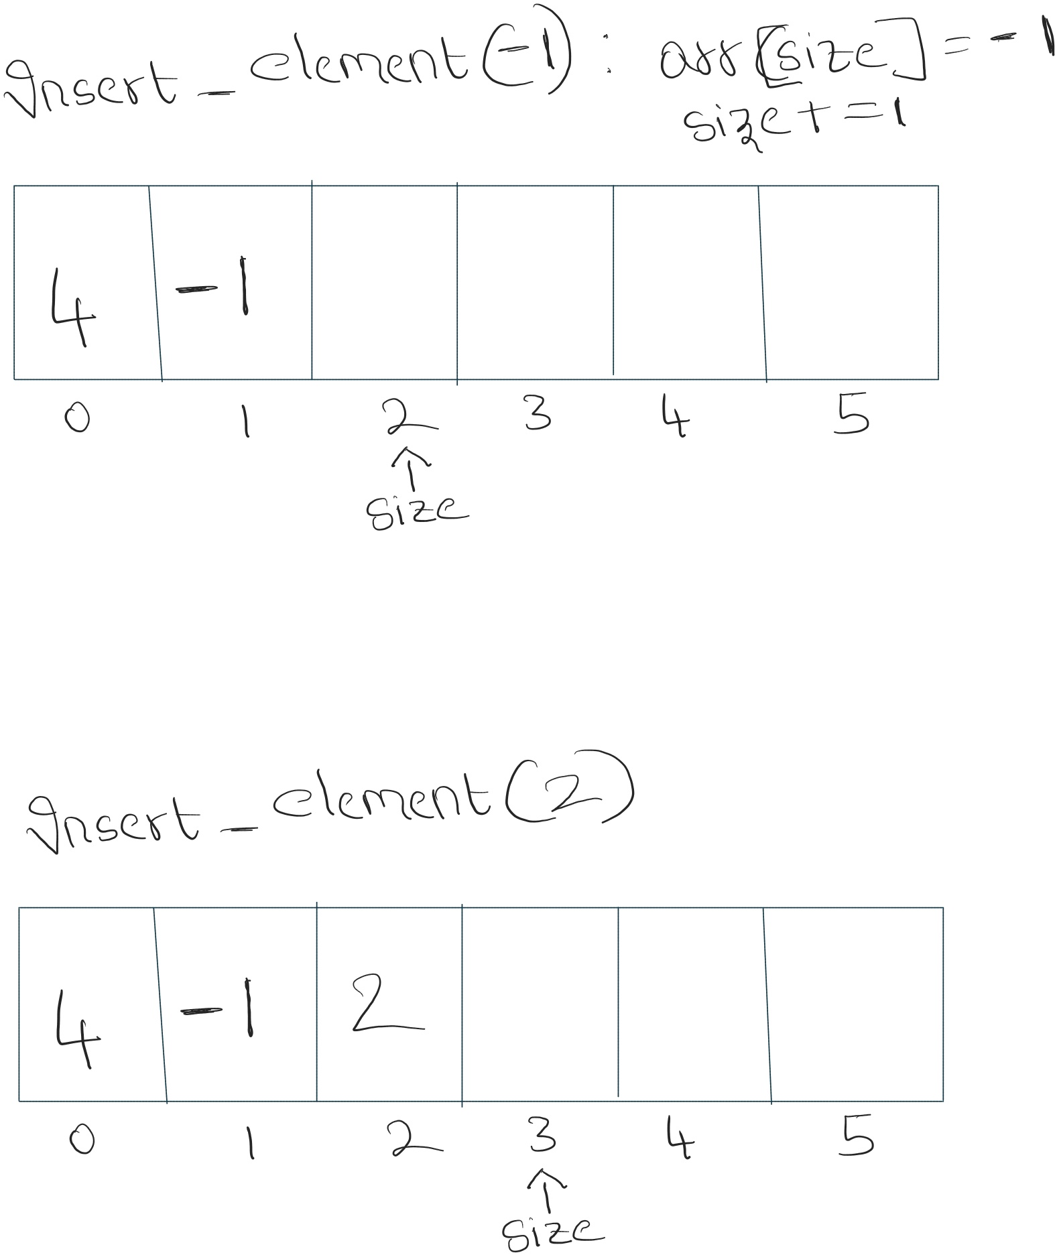

Slide 13
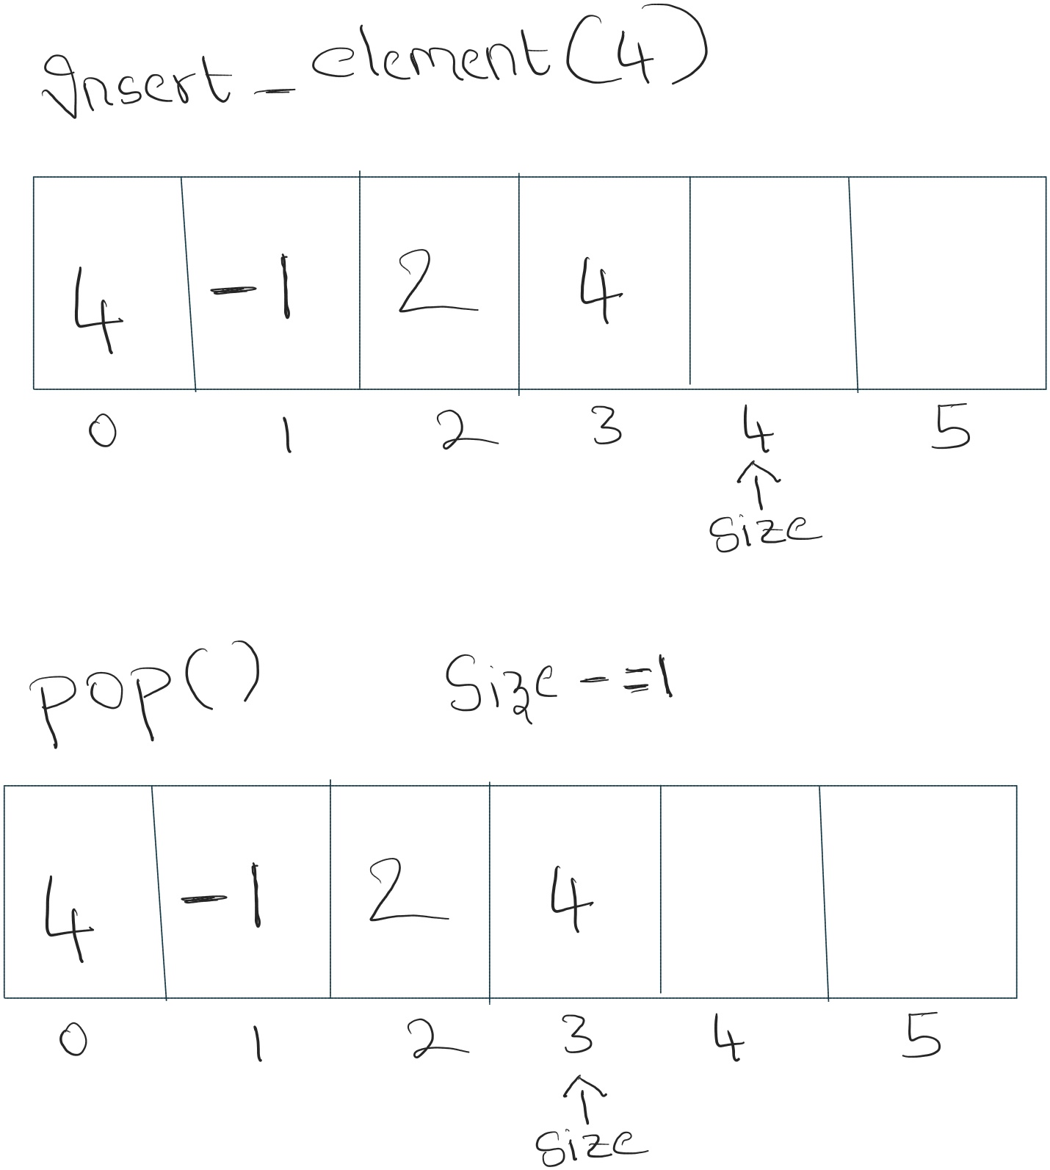

Slide 14
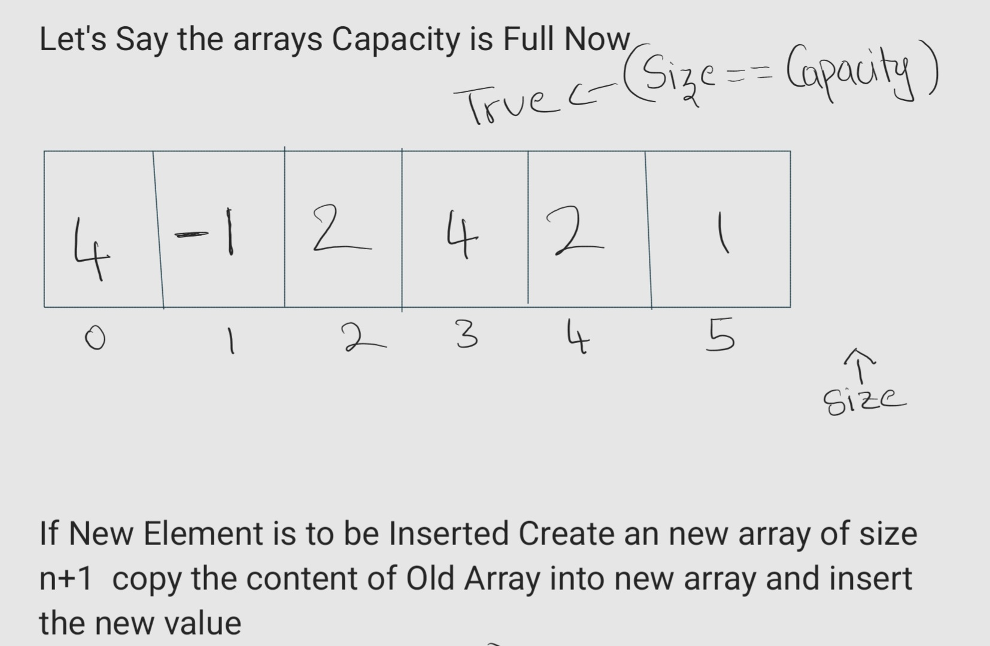

Slide 15
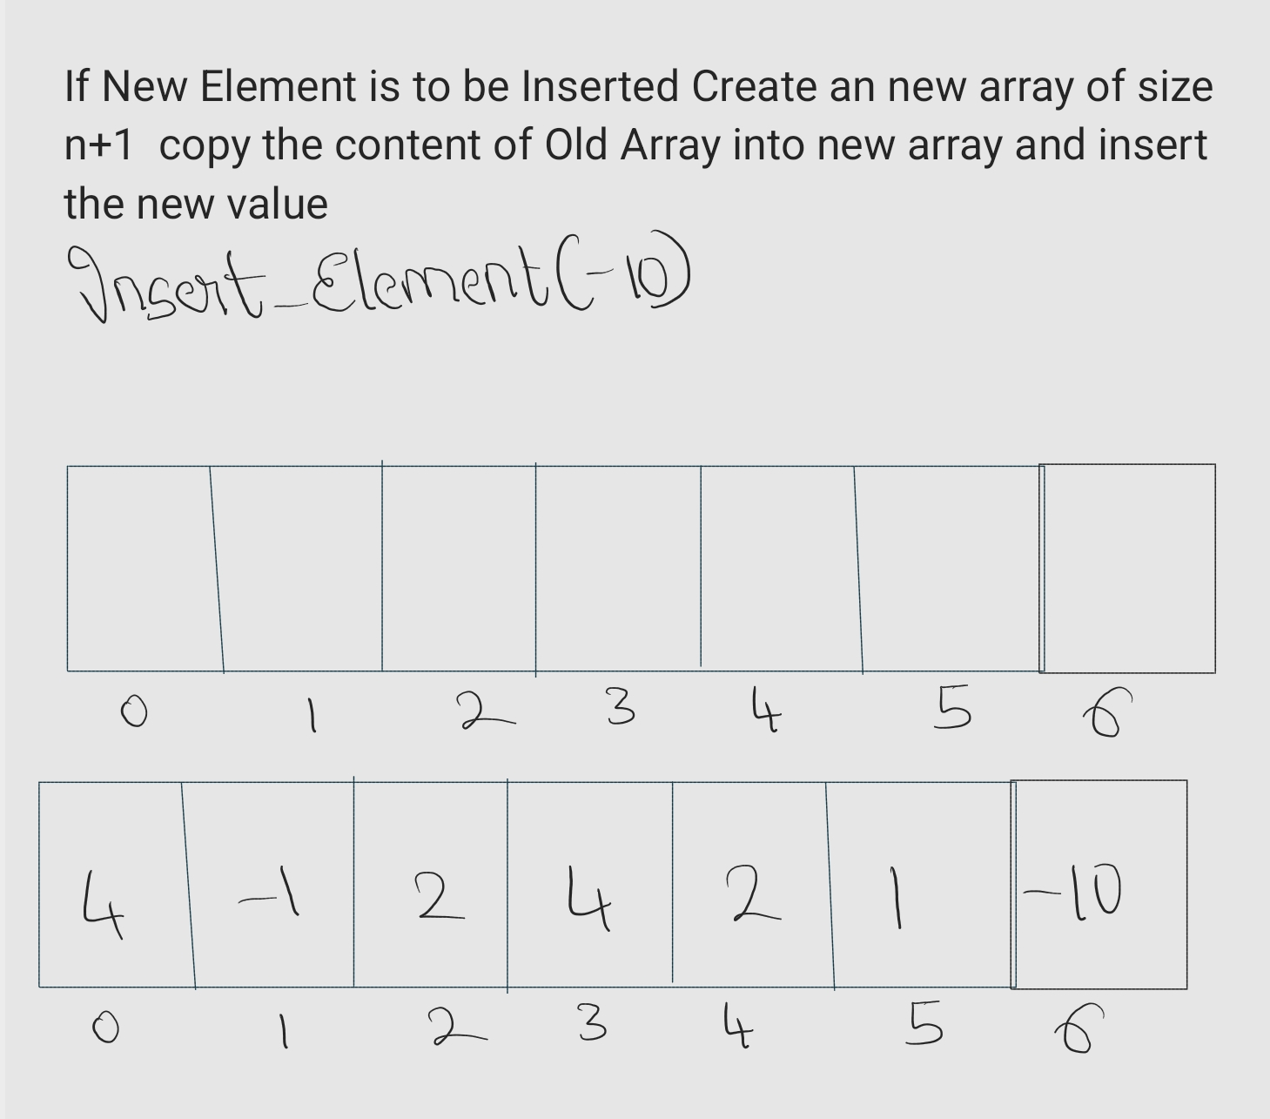

Slide 16
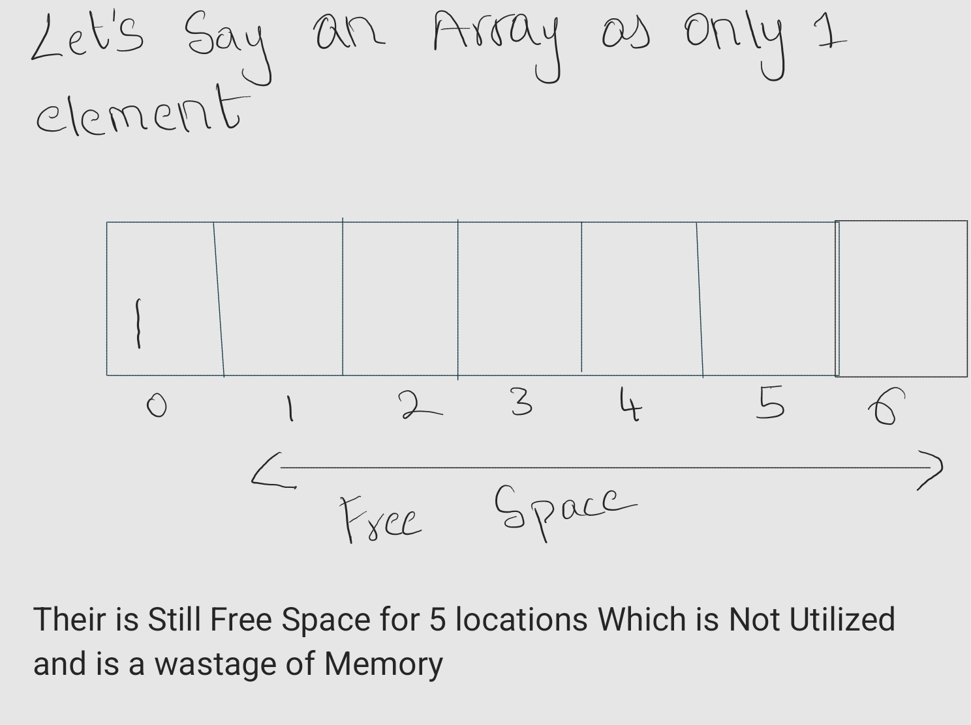

Slide 17
Time Complexity Of Operations
Creating an Array:
Time Complexity: O(1) (constant time)
Explanation: In most languages, allocating memory for an array and setting its initial size is a basic operation that executes in a constant amount of time, regardless of the array's size.

Slide 18
Getting the ith Element:
Time Complexity: O(1) (constant time)
Explanation: Accessing an element by its index in an array involves direct calculation and lookup, making it independent of the array's size.
Searching for a Target Element:
Time Complexity:
O(n) (linear time)
Explanation:
This involves iterating through each element, comparing it to the target. In the worst case, where the target isn't found, all elements are examined, leading to O(n) time complexity.

Slide 19
Traversing the Array:
Time Complexity: O(n) (linear time)
Explanation: Visiting each element in the array, regardless of the operation performed on it, takes linear time.
Inserting Elements into Array:
Time Complexity: O(1) Linear Time
Explanation: Accessing an element by its index in an array involves direct calculation and lookup, making it independent of the array's size.

Slide 20
Insertion above the Capacity Of Array
Let's say We have Declared an Array of Size N and we Want to Insert n+1 Elements
Solution :
Create a New Array of Size n+1
Copy the Elements of Old Array into New Array
And add The New Element at index N(Remember indexing Starts From Zero)
Time Complexity: O(N)
Explanation: The key point is that step 2 takes the most time because you're touching each item once. Since there are n items, this step is O(n). Even though steps 1 and 3 are faster, they don't affect the overall complexity as much as the linear step

Slide 21
Drawbacks of Using Arrays
Fixed Size:
Once declared, an array's size cannot be changed dynamically. This means you need to know the exact number of elements you'll need beforehand, which can be limiting if your data is flexible or unknown.
If you allocate more space than needed, you waste memory. If you allocate too little, you'll need to create a new array and copy all the elements, leading to performance overhead.

